Slide 1
Context-awareness
BLM5134 – Week 2

Slide 2
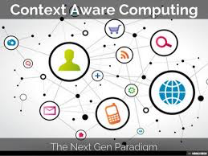
What is Context-Awareness?
desktop applications
web applications
mobile computing
pervasive/ubiquitous computing
Notes:
However, context-aware computing became more popular with the in- troduction of the term ‘ubiquitous computing’ by Mark Weiser [1] in his ground-breaking paper The Computer for the 21st Century in 1991. Then the term ‘context-aware’ was first used by Schilit and Theimer [2] in 1994.
The definitions for ‘context’ and ‘context-awareness’ that are widely accepted by the research community today were proposed by Abowd et al. [3] in 1999.

Slide 3
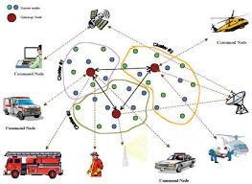
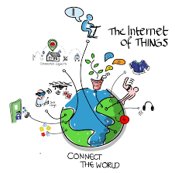
IoT and Sensor Networks
Sensors
powerful
cheaper
smaller in size
IoT
billions of sensors are connected
to the Internet
Big Data
Middleware solutions

Slide 4
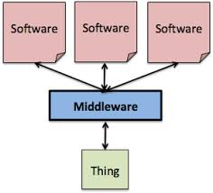
What is Middleware?
Middleware is a software layer that stands between the networked operating system and the application and provides well known reusable solutions to frequently encountered problems like heterogeneity, inter- operability, security, dependability.
Notes:
Some of the major sensor network middleware approaches
are IrisNet, JWebDust, Hourglass, HiFi, Cougar, Impala,
SINA, Mate, TinyDB, Smart Object, Agilla, TinyCubus,
TinyLime, EnviroTrack, Mires, Hood, and Smart Messages

Slide 5
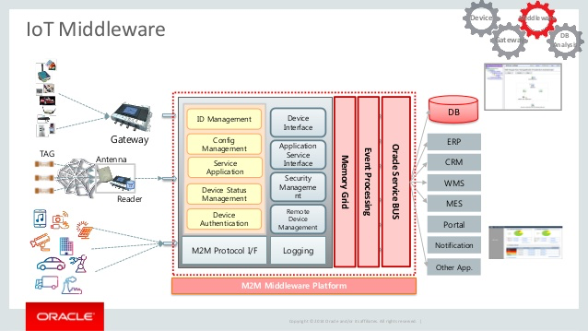
Middleware Solutions for IoT
device management
interoperability
platform portability
context-awareness
security and privacy

Slide 6
Evolution of Internet
Notes:
In the late 1960s, communication between two computers was made possible through a computer network [17].
In the early 1980s the TCP/IP stack was introduced. Then, commercial use of the Internet started in the late 1980s.
Later, the World Wide Web (WWW) became available in 1991 which made the Internet more popular and stimulate the rapid growth.
The term ‘Internet of Things’ was firstly coined by Kevin Ashton [27] in a presentation in 1998.
Later, IoT was formally introduced by the International Telecommunication Union (ITU) by the ITU Internet report in 2005

Slide 7
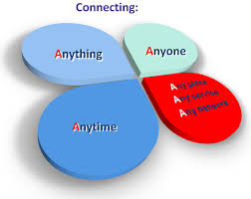
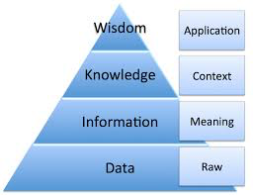
Definitions of IoT
“Things have identities and virtual personalities operating in smart spaces using intelligent interfaces to connect and communicate within social, environment, and user contexts.”

Slide 8
Definitions of IoT
“The semantic origin of the expression is composed by two words and concepts: Internet and Thing, where Internet can be defined as the world-wide network of interconnected computer networks, based on a standard communication protocol, the Internet suite (TCP/IP), while Thing is an object not precisely identifiable Therefore, semantically, Internet of Things means a world-wide network of interconnected objects uniquely addressable, based on standard communication protocols.”

Slide 9
Definitions of IoT
“The Internet of Things allows people and things2 to be connected Anytime, Anyplace, with Any- thing and Anyone, ideally using Any path/network and Any service.”

Slide 10
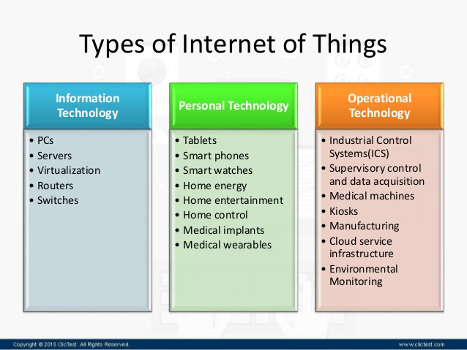
IoT App Categories
Notes:
By 2020, there will be 50 to 100 billion devices connected to the Internet [
smart cities, smart environment, smart water, smart metering, security and emergencies, retail, logistics,
industrial control, smart agriculture, smart animal farming,
domestic and home automation, and eHealth

Slide 11
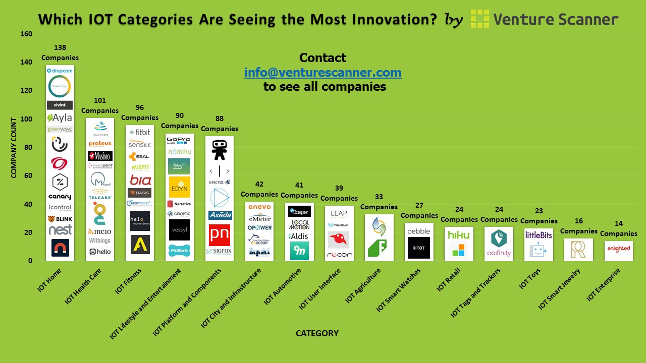
IoT App Categories

Slide 12
Sensor Networks
Notes:
Capability means the processing, mem- ory, communication, and energy capacity. Capabilities increase from layer one to layer six.
There are several other technologies that can provide ac- cess to sensor hardware, such as wireless ad-hoc networks. However, they are not scalable and cannot accommodate the needs of the IoT individually
The IoT comprises sensors and actuators. The data is collected using sensors. Then, it is processed and decisions are made. Finally, actuators perform the decided actions.
From their origin, SNs were designed, developed, and used for specific application purposes, for example, detecting bush fire

Slide 13
Relationship between Sensor Networks and IoT

Slide 14
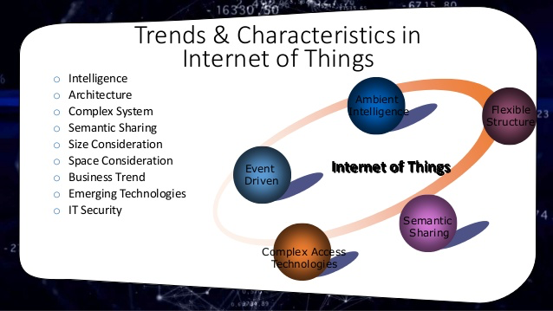
Major Chracteristics for IoT
intelligence
fuse sensor data
architecture
Event-driven, time-driven
complex system
Sensors, actuators
size considerations
50-100 billion devices
time considerations
Real-time data processing
space considerations
location plays a significant role in context-aware computing
everything-as-a-service
Sharing would be essential

Slide 15
What is Context ?
“Context is any information that can be used to characterise the situation of an entity. An entity is a person, place, or object that is considered relevant to the interaction between a user and an application, including the user and applications themselves”
“

Slide 16
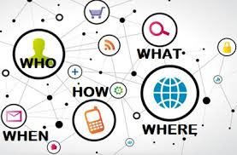
What is Context ?
Circumstance, situation, phase, position, posture, attitude, place, point; terms; regime; footing, standing, status, occasion, surroundings, environment, location, dependence.”

Slide 17
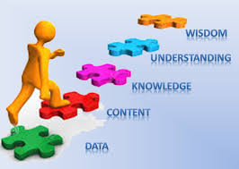
Raw Data and Context Information
Raw (sensor) data: Is unprocessed and retrieved directly from the data source, such as sensors.
Context information: Is generated by processing raw sen- sor data. Further, it is checked for consistency and meta data is added.

Slide 18

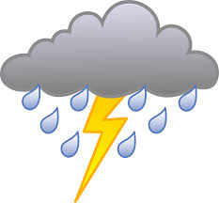
Events
Discrete Events
Continuous Events

Slide 19
Context-Awareness
“A system is context-aware if it uses context to provide
relevant information and/or services to the user, where relevancy depends on the user’s task.
Context awareness frameworks typically should support
acquisition
representation
delivery
reaction

Slide 20
Context Model and Context Attribute
A context model identifies a concrete subset of the context that is realistically attainable from sensors, applications and users and able to be exploited in the execution of the task. The context model that is employed by a given context-aware application is usually explicitly specified by the application developer, but may evolve over time.
A context attribute is an element of the context model describing the context. A context attribute has an identifier, a type and a value, and optionally a collection of properties describing specific characteristics

Slide 21
Quality of Context
context data validity
context data precision
context data up-to-dateness

Slide 22
Categories of Context

Slide 23
A different Approach
Sensed: Sensor data directly sensed from the sensors, such as temperature measured by a temperature sensor. Values will be changed over time with a high frequency.
Static: Static information which will not change over time, such as manufacturer of the sensor, capabilities of the sensor, range of the sensor measurements.
Profiled: Information that changes overtime with a low frequency, such as once per month (e.g. location of sensor, sensor ID).
Derived: The information computed using primary context such as distance of two sensors calculated using two GPS sensors.

Slide 24
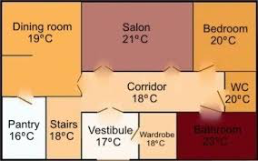
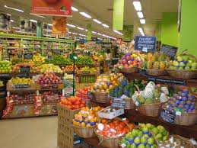

Levels of Context Awareness
Personalisation
Passive context-awareness
Active context-awareness
Notes:
For example, users may set the preferred temperature in a smart home environment where the heating system of the home can maintain the specified temperature across all rooms.
For example, when a user enters a super market, the mobile phone alerts the user with a list of discounted products to be considered.
For example, if the smoke detectors and temperature sensors
detect a fire in a room in a smart home environment, the system will automatically notify the fire brigade as well as the owner of the house via appropriate methods such as phone calls.

Slide 25
Characteristics of Context-Awareness
1) is sensed though sensors or sensor networks
2) is sensed by small and constrained devices
3) originates from distributed sources
4) is continuously changing
5) comes from mobile objects
6) has a temporal character
7) has a spatial character
8) is imperfect and uncertain.

Slide 26
Context LifeCycle

Slide 27
Context LifeCycle
1) Information Lifecycle Management (ILM) [110]: cre- ation and receipt → distribution → use → maintenance → disposition → ...
2) Enterprise Content Management (ECM) [111]: capture → manage → store → preserve → deliver → ...
3) Hayden’s Data Lifecycle [112]: collection → relevance → classification → handling and storage → transmis- sion and transportation → manipulate, conversion and alteration → release → backup → retention destruction → ...
4) Intelligence Cycle [113]: collection → processing → analysis→ publication → feedback → ...
5) Boyd Control Loop (also called OODA loop) [114]: observe → orient → decide → act → ...

Slide 28
Context Lifecycle
6) Chantzara and Anagnostou Lifecycle [115]: sense (con- text provider) → process (context broker) → disseminate (context broker) → use (service provider) → ...
7) Ferschaetal.Lifecycle[116]:sensing→transformation → representation → rule base → actuation → ...
8) MOSQUITO [117]: context information discovery → context information acquisition → context information reasoning → ...
9) WCXMS Lifecycle [109]: (context sensing → context transmission → context acquisition → ... ) → context classification → context handling → (context dissemi- nation → context usage → context deletion → context request →... ) → context maintenance → context dis- position →...
10) Baldauf et al. [10]: sensors → raw data retrieval → reprocessing → storage → application.

Slide 29
Context Acquisition
Based on Responsibility
Pull and Push
Based on Frequency
Instant and Interval Events
Based on Source
Sensor Hardware, Middleware, Context Servers
Based on Sensor Types
Physical, Virtual (calendar, contact number directory, twitter statuses, email and chat applications) and Logical (weather information)
Based on Acquisition Process
Sense,Derive,Manually

Slide 30
Context Modelling
Key-Value Modelling
Markup Scheme Modelling (Tagged Encoding)
XML, JSON, ContextML, …
Graphical Modelling
UML, ORM
Object Based Modelling
Logic Based Modelling
Ontology Based Modelling

Slide 31
Context Reasoning Decision Models
Context pre-processing
Sensor data fusion
Context inference
supervised learning, unsupervised learning, rules, fuzzy logic, ontological reasoning and probabilistic reasoning.

